Slide 1
Tips and Information
Thank you for choosing to share these slides. Please recognize the National Center for PTSD as the source and keep the NCPTSD template intact during your presentation. This presentation may be used in whole or in part.
If you use links to videos in YouTube, you may want to install ad blocker software on your computer to avoid advertisements that sometimes play before videos.
Notes:
Tips and Information
Thank you for choosing to share these slides. Please recognize the National Center for PTSD as the source and keep the NCPTSD template intact during your presentation. This presentation may be used in whole or in part.
If you use links to videos in YouTube, you may want to install ad blocker software on your computer to avoid advertisements that sometime play before videos.

Slide 2

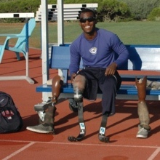

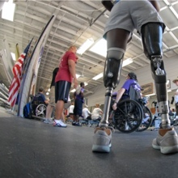

Posttraumatic Stress Disorder:
Overview, Treatment, and Resources
[Insert Presenter Information]
VETERANS HEALTH ADMINISTRATION
Veterans Administration National Center for Posttraumatic Stress Disorder (PTSD) logo
Updated January 2022

Slide 3
What is PTSD?
Daily hassles can include a car breaking down or doing chores.
Major life events can include losing a job, divorce, buying a new home or getting married.
Serious traumatic events can include war zone exposure, physical or sexual assault, serious accidents, child sexual or physical abuse, mass violence, hate crimes, or disasters.
Notes:
Posttraumatic stress disorder (PTSD) is a mental health problem that people can develop after going through or seeing a life-threatening event. It can also be caused by learning about the violent or accidental death or injury of a loved one.
Because they involve matters of life and death, these events are different than stressful events like losing a job, getting a divorce or even good things like buying a home or getting married. And they are different than the daily hassles we all experience – like a car breaking down or doing chores.

Slide 4
What are the symptoms of PTSD?
Experiencing unwanted memories
Avoiding reminders of the event
Having negative thoughts and feelings
Feeling on edge
Download the What is PTSD? video
Notes:
Everyone with PTSD experiences it differently, but to be diagnosed with PTSD, four types of symptoms must be present:
Experiencing unwanted memories
Avoiding reminders of the event
Having negative thoughts and feelings
Feeling on edge
[Optional video: This brief video explains the causes and symptoms of PTSD.]

Slide 5
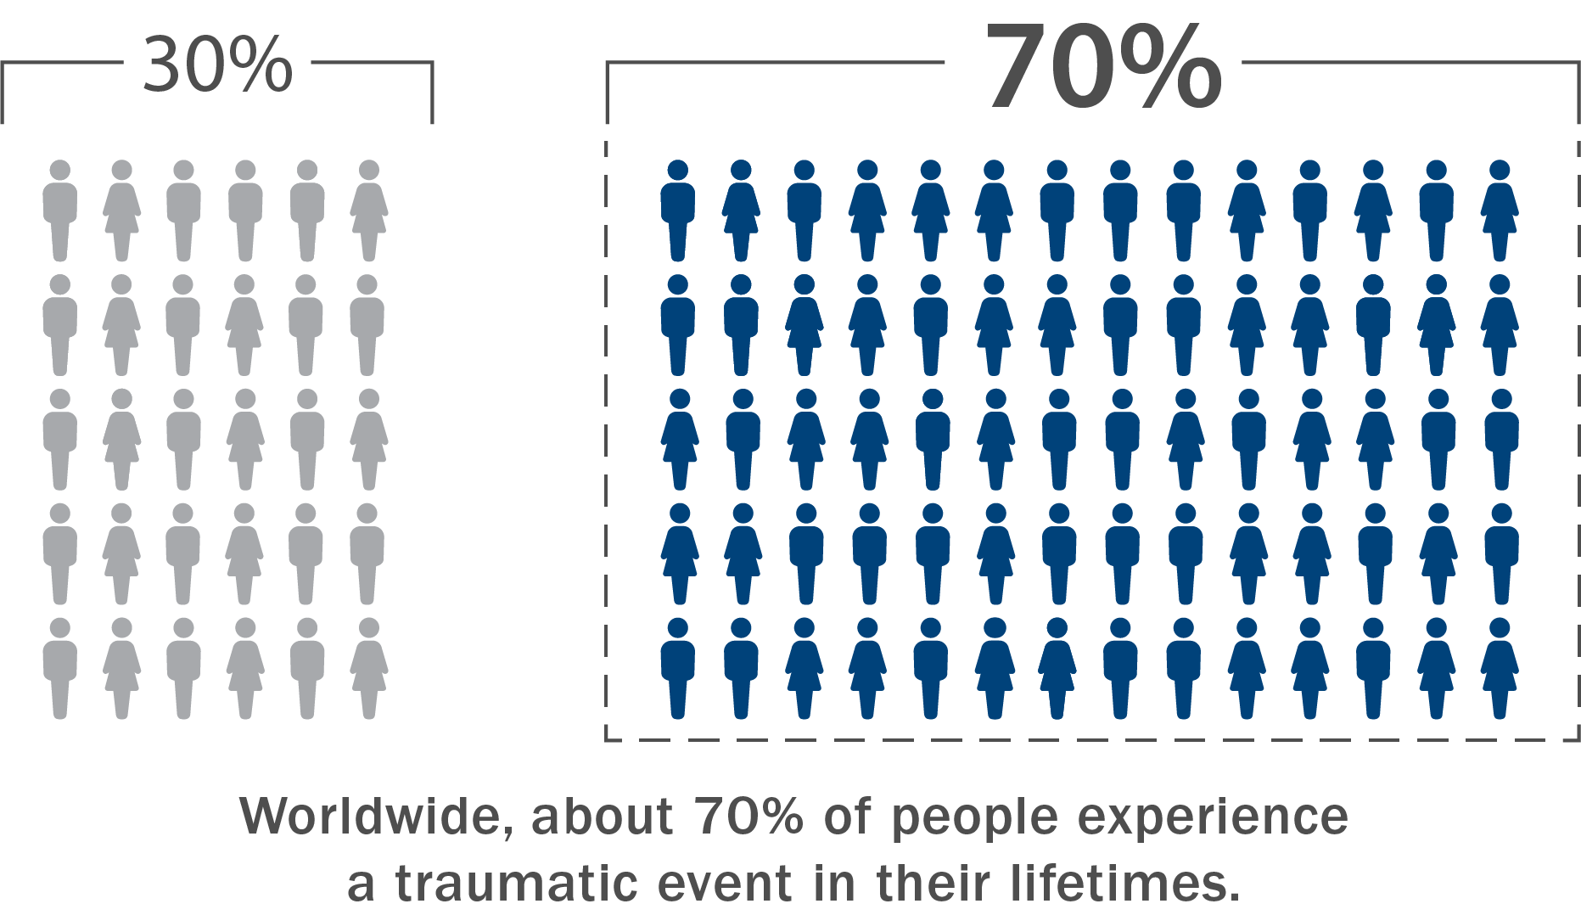
Trauma is Common and So Are Symptoms
Notes:
Worldwide, about 70% of people experience a traumatic event in their lifetimes. Many have experienced more than one. That means that most of the people you meet every day have probably experienced a trauma at some point.
While the experience of trauma is widespread, some groups of people are more likely to experience it. Veterans, people who are members of the LGBTQ+ community, people experiencing poverty, and Black, Indigenous, and people of color (BIPOC) individuals are more likely to have a traumatic event happen to them.
It’s normal to have upsetting memories, feel on edge, or have trouble sleeping after this type of event. Most people will start to feel better after a few months.

Slide 6

For Most, Symptoms Fade over Time
Notes:
But if it’s been longer than a few months and the thoughts and feelings remain, it may be PTSD.
For some people, PTSD symptoms may start later on, or they may come and go over time.

Slide 7
Symptoms of PTSD
Unwanted memories
For example: nightmares, flashbacks
Avoiding reminders
For example: avoiding crowds, keeping busy all the time
Negative thoughts and feelings
For example: feeling guilty, feeling that the world is dangerous
Feeling on edge
For example: trouble sleeping, feeling jittery, being quick to anger
Learn more on YouTube at How I knew I had PTSD
Notes:
Earlier, I mentioned the four types of symptoms people with PTSD have
Experiencing unwanted memories
Avoiding reminders of the event
Having negative thoughts and feelings
Feeling on edge
For each type of symptom, there are many specific features that may be present.
[Optional video: Listen to how these Veterans describe their symptoms.]

Slide 8
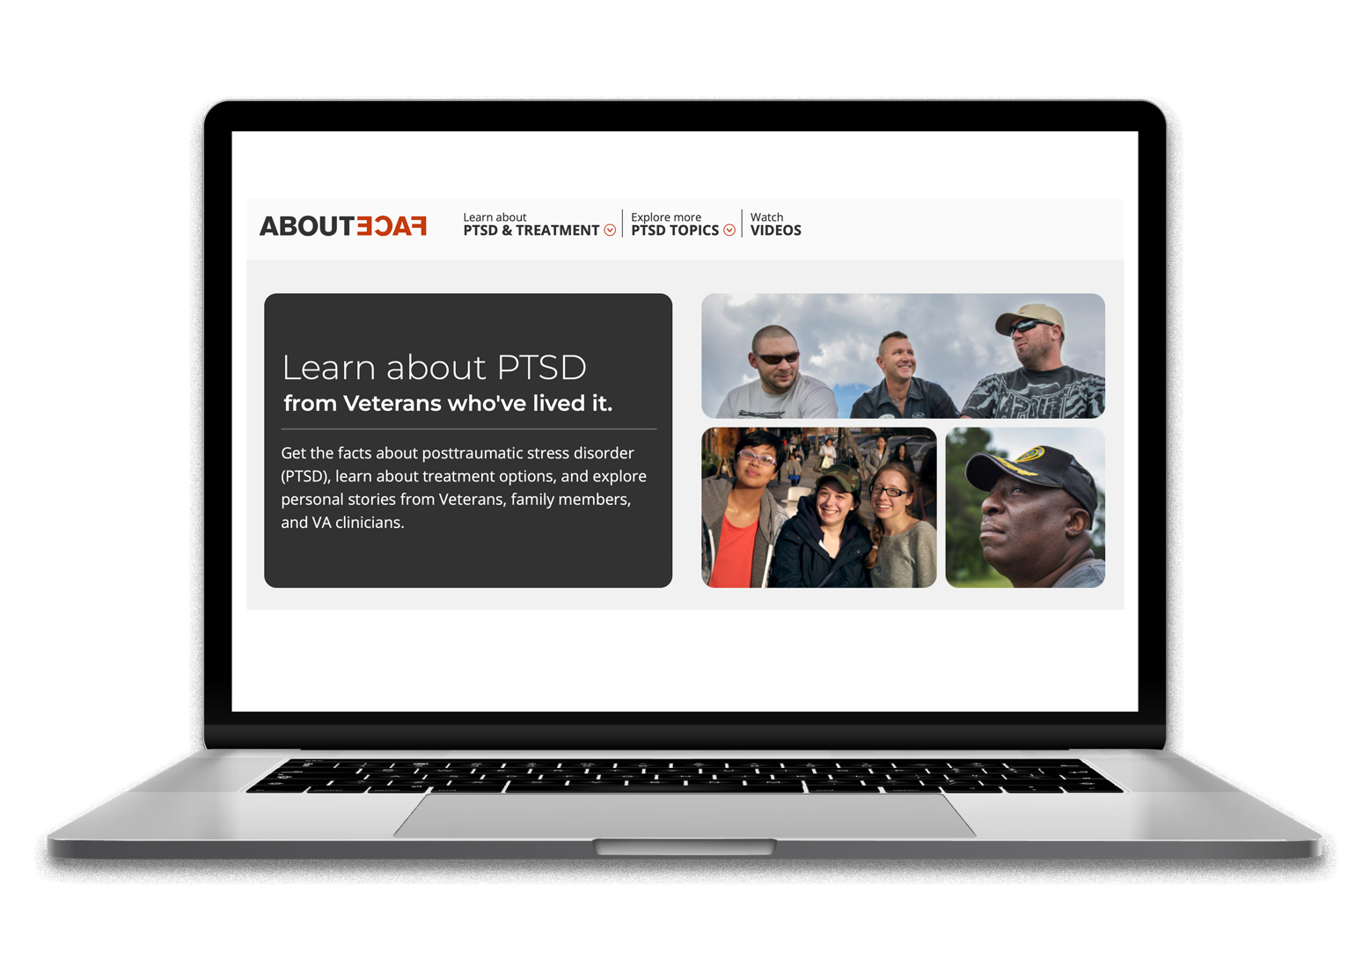
PTSD: A Personal Perspective
Learn more at: https://www.ptsd.va.gov/apps/AboutFace/
Notes:
For more than ten years, the National Center for PTSD has been featuring Veterans’ stories of living with PTSD on the website AboutFace.
Veterans from an array of eras and branches of service describe how their PTSD affects them and their loved ones and how PTSD treatment turned their lives around. AboutFace is a great place to see how PTSD symptoms play out in Veterans’ everyday lives, and to learn more about treatment and recovery from PTSD

Slide 9
Risk Factors for PTSD
Personal factors
For example: prior trauma, younger age, female gender
The traumatic event
For example: very severe trauma, physical or sexual assault, feeling very helpless during the trauma
Recovery environment
For example: low social support, stressful life events, new trauma
Notes:
Why do some people develop PTSD while others don’t? There are several factors that have an impact on whether someone develops PTSD, including risk factors associated with the person, with the traumatic event they experience, and with their lives afterwards -- the recovery environment.
These risk factors are important, but we can’t say that someone will definitely develop trauma after PTSD because of any of them.

Slide 10

The Recovery Environment
Notes:
The recovery environment risk factors are important because they can be changed. For example, if additional stressors can be avoided, the chance of developing PTSD can be decreased. Social support after the traumatic event is also key.
We know that children who disclose abuse and are believed are less likely to develop PTSD than those who are not believed.
Because social support is so important, family and friends have a crucial role to play in fostering recovery from PTSD.

Slide 11
How do PTSD symptoms affect family and friends?
Unwanted memories and nightmares
Flashbacks can be intense to witness
Nightmares can wake other family members
Avoiding reminders
Loved ones can be frustrated if the person with PTSD avoids shopping, traveling, or public events
Negative emotions
People with PTSD may have trouble expressing love to the people they care about
View the YouTube video Everyone who’s close to me also serves, also pays a price
View the YouTube video I had no idea which person I was getting today
Notes:
At the same time, family and friends may face their own challenges. A person’s PTSD symptoms can affect their loved ones.
[Optional videos:
Option one:
Army Veteran Curtis Thompson explains how PTSD has affected his relationships with people he cares about.
Option two:
Oliva Jefferson, daughter of a Veteran with PTSD, talks about the signs she saw in her father while growing up]

Slide 12
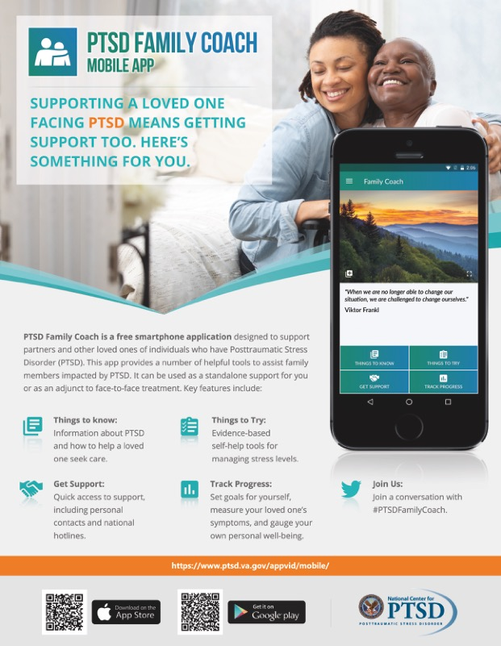
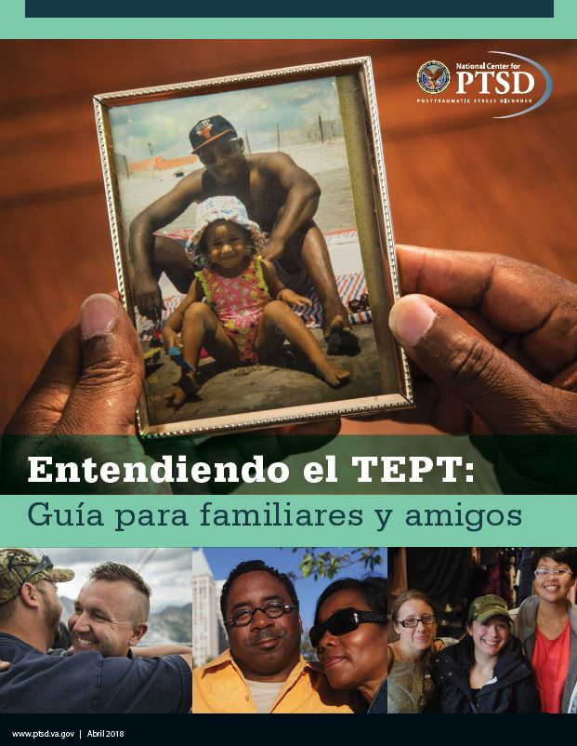
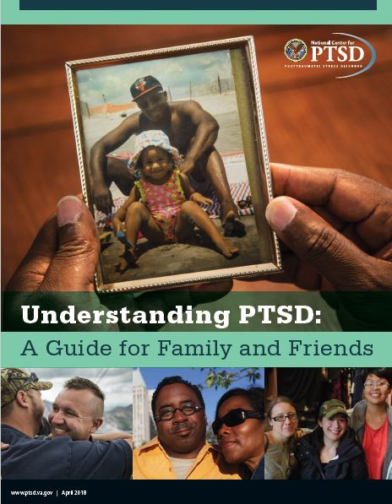
Resources for Family and Friends
Understanding PTSD: A Guide for Family and Friends
Entendiendo el TEPT: Una guía para familia y amigos
PTSD Family Coach app
Notes:
The National Center for PTSD has resources for friends and family to help them understand and support their loved ones.

Slide 13
Resources for Family and Friends:
Helping with Treatment
CPT: Helping during treatment https://www.ptsd.va.gov/family/how_help_cpt.asp
PE: Helping during treatment https://www.ptsd.va.gov/family/pe_tx.asp
EMDR: Helping during treatment https://www.ptsd.va.gov/family/how_help_emdr.asp
WET: Helping during treatment https://www.ptsd.va.gov/family/wet_help_treatment.asp
Notes:
One way that family members can help is by encouraging their loved ones to get and stay in treatment. NCPTSD articles on four of the most effective PTSD treatments explain the basics of the treatments and what loved ones can do to encourage engaging fully in them.

Slide 14
PTSD Treatment is Effective
Reduce or eliminate symptoms
Improve relationships
Cope with life’s ups and downs
Find hope for the future
Go to YouTube to view the It feels beautiful video
Notes:
Treatment for PTSD – in the form of trauma-focused therapy – gives a person the best chance of recovery. Other therapies and certain medications can also be effective. It works. For some people, treatment gets rid of symptoms altogether. For others, it can make those symptoms less intense. Treatment has a host of benefits.
[Optional video: Army Veteran Ace Carter describes how his life has changed thanks to PTSD treatment.]

Slide 15
Trauma-focused Therapy is Best
Trauma-focused therapy is effective
Memories of the trauma are the focus
Relief can come in a matter of weeks
Relief can last after treatment is over
View the YouTube video [Counseling] allowed me to see things
a little bit differently and a little clearer
Notes:
We use the term “trauma-focused therapy” to mean treatment that focuses on the memory of the trauma and its meaning. Focusing on trauma memories can sound scary – and you’ll remember that avoiding memories is a symptom of PTSD – but doing it under the care of a trained professional can help a person with PTSD feel better. For most people, improvement starts to happen after only a few weeks or months of treatment.
[Optional video: Air Force Veteran Reedy Hopkins shares how therapy helped him see things differently.]

Slide 16
The Most Effective Therapies
Cognitive Processing Therapy | Prolonged Exposure Therapy | Eye Movement Desensitization and Reprocessing (EMDR)
helps people recognize how trauma has changed their view about themselves, others, and the world and helps them to recognize the negative thoughts that are created by the trauma | teaches people how to confront memories, feelings, and situations they have avoided since the trauma | helps people process the trauma by paying attention to a back-and-forth movement or sound while calling to mind the upsetting memory until shifts occur in the way that memory is experienced
Watch the Cognitive Processing Therapy video
To learn more, view the Prolonged Exposure Therapy video
View the EMDR video
Notes:
The most effective therapies are Cognitive Processing Therapy, Prolonged Exposure Therapy, and Eye Movement Desensitization and Reprocessing – or EMDR.
Research shows that the beneficial effects of these trauma-focused therapies are maintained over time.
[Optional videos
In these videos, experienced PTSD treatment providers talk about what treatment is like]

Slide 17
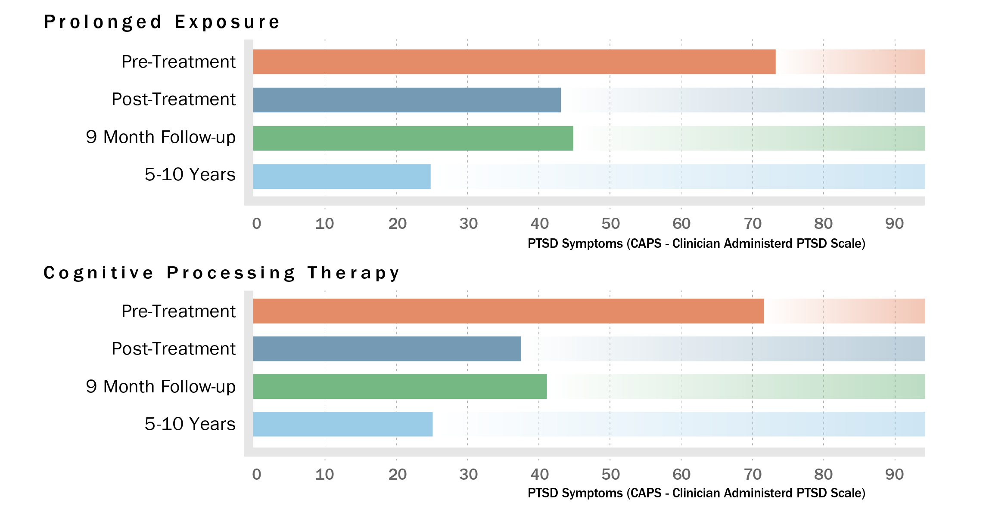
Trauma-focused psychotherapy works.
Resick, Patricia A: Nishith, Pallavi: Weaver, Terri L: Astin, Millie C.: Feuer, Catherine A. Journal of Consulting and Clinical Psychology, Vol 70(4), Aug 2002, 867-879. doi: 10.1037/0022-006X.70.4.867
Notes:
The Clinician-Administered PTSD Scale --- the CAPS --- is our gold standard for measuring PTSD. A CAPS in the 70s would be considered severe PTSD for the CAPS-4 which is what you see here. Both Prolonged Exposure and Cognitive Processing Therapy result in very large changes on the CAPS that are maintained at post-treatment and 9-month follow up. But even more exciting is that when the researchers went back five to ten years later to check on these people, and a few new people who had enrolled since the study had started, the results looked even better. CAPS scores continued to drop to about 25 which is the mild or sub-threshold range. About 80% of study participants no longer met criteria for PTSD.

Slide 18
Other Psychotherapies
Written Exposure Therapy | Present-Centered Therapy
helps the person find new ways to think about that event and what it means by writing about the trauma and talking to a provider about what they’ve written | teaches people problem-solving skills to cope with stressors related to the trauma
View the video Written Exposure Therapy
Notes:
Two other psychotherapies -- Written Exposure Therapy and Present-Centered Therapy, – are also effective treatments for PTSD.
A course of Written Exposure Therapy can be completed in 5 sessions. In Present-Centered Therapy, the focus is on problem-solving, rather than on the trauma itself.

Slide 19

Medication is Also Effective
Sertraline (Zoloft)
Venlafaxine (Effexor)
View the I really struggled with medication for a long time
video on YouTube
Notes:
In addition to these talk therapies, there are two effective medications for PTSD. Sertraline – or Zoloft – and venlafaxine – also known as Effexor – work well to relieve the symptoms of PTSD.
One advantage of medication is that many medical providers can prescribe it. One disadvantage is that it only works as long as the person is taking it. Some people also experience side effects when taking medications.
[Optional video: Army Veteran Sherie Warner explains how hard it was for her that she needed medication to help her manage her PTSD symptoms.]

Slide 20
What about Benzodiazepines?
Safety concerns
Limited value
Risk of addiction
Even more risky for older people
Benzodiazepines are NOT recommended for PTSD treatment.
Notes:
Benzodiazepines, sometimes called “benzos,” are anxiety medications that are used to help people in the short term. They have safety concerns, however, and are not recommended for PTSD treatment.

Slide 21
A Mind-Body Approach
Mind-body approaches to treatment are outside of conventional medical treatment that may be used in conjunction with, or in the place of, conventional medical treatment.
  Mindfulness-Based Stress Reduction (MBSR)
Notes:
Some patients may prefer a mind-body approach as an alternative to – or alongside – psychotherapy or medication. The most effective mind-body approach is Mindfulness-Based Stress Reduction (MBSR).
MBSR trains people to focus attention on thoughts, sensations, and feelings as they appear and in a non-judgmental way. It incorporates techniques such as mindful yoga, body scans, meditation, and remaining mindful in daily life.

Slide 22
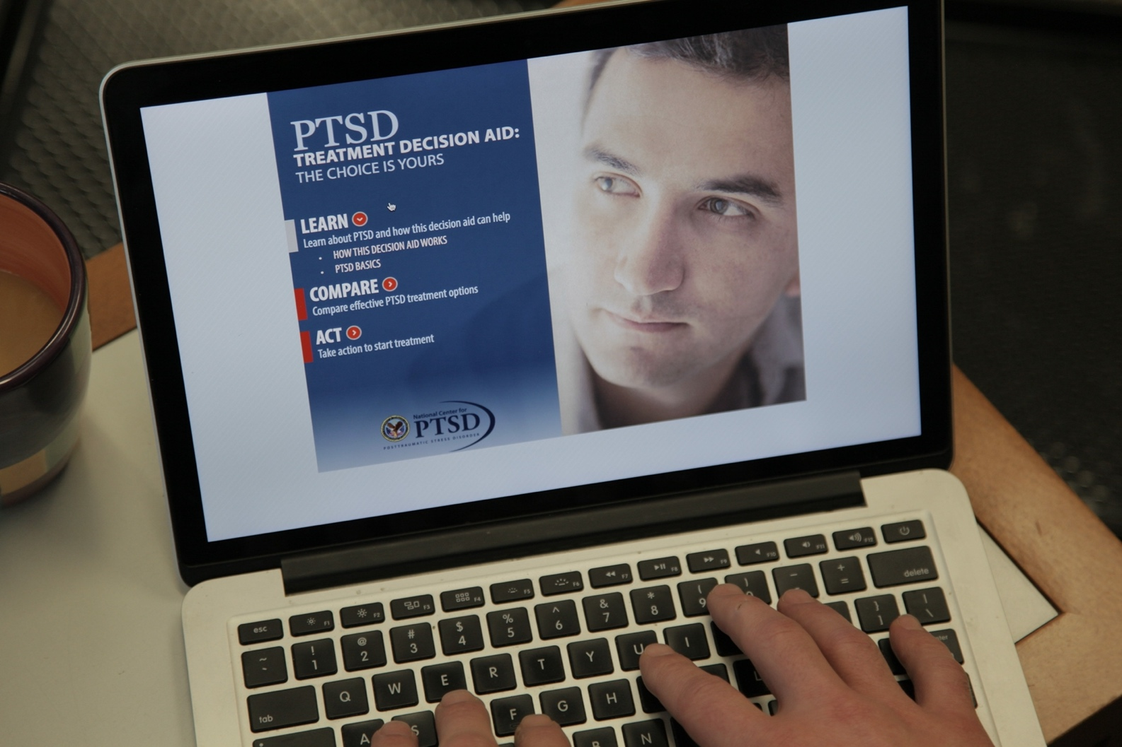
Deciding on a Treatment
Learn more at: https://www.ptsd.va.gov/apps/Decisionaid/
View the YouTube video PTSD Treatment Decision Aid
Notes:
With so many effective treatments to choose from, it may be challenging for people to decide which one is best. The PTSD Treatment Decision Aid can help. It is available online at the National Center for PTSD website.
Users can move through PTSD Treatment Decision Aid step-by-step or jump to the sections that most interest them. They can read information and watch videos about effective treatments, compare features of the treatments they like best, and get answers to common questions about PTSD treatment.
[Optional video: Here’s a quick look at how the PTSD Treatment Decision Aid can be used.]

Slide 23


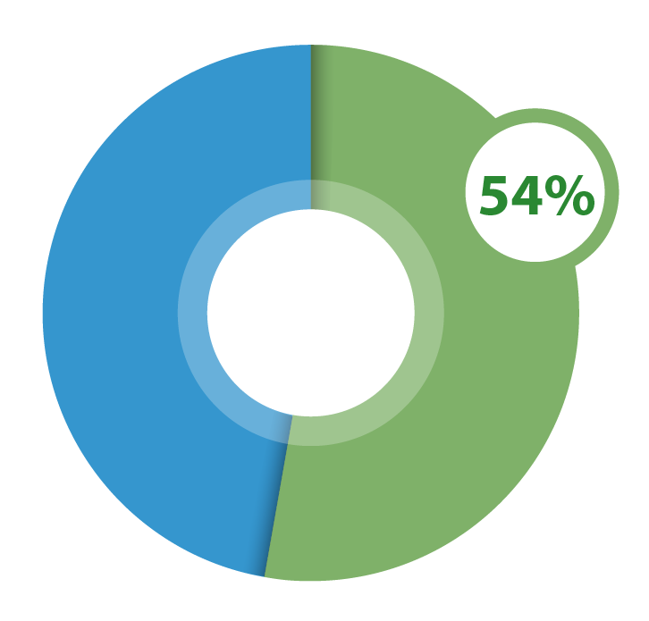
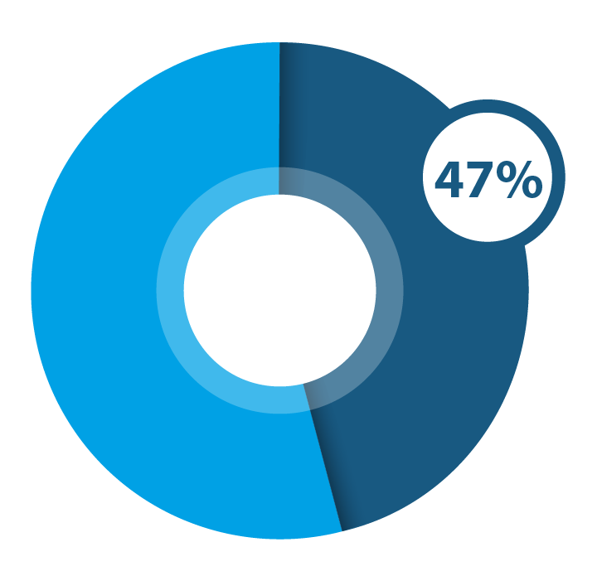
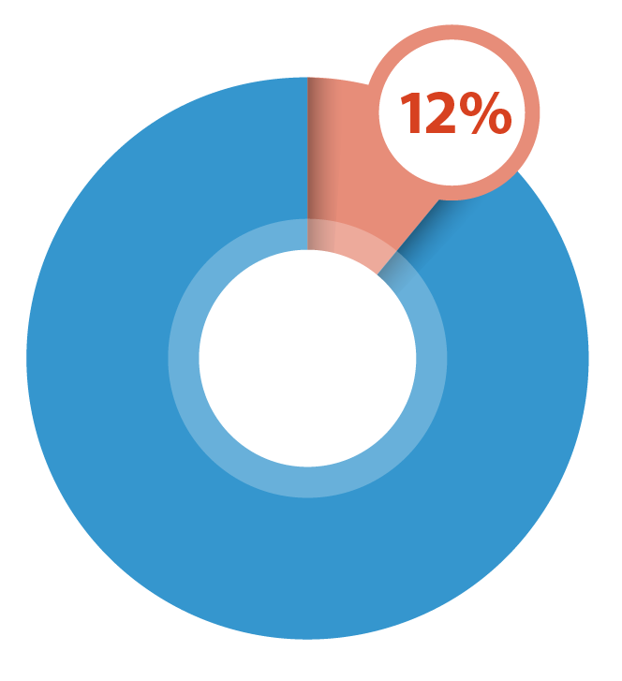
Trauma-focused psychotherapy is the best treatment.
Trauma-focused Psychotherapy
Medication
No Treatment
54 OUT OF 100
47OUT OF 100
BUT ONLY
12 OUT OF 100
people who receive this treatment will no longer have PTSD after about 3 months of treatment.
people who take medication will no longer have PTSD.
people who don’t get treatment will no longer have PTSD.
Notes:
One of the most important things to know about PTSD treatment is that it is effective. The majority of people with PTSD who get a course of trauma-focused treatment or who take the medications we talked about earlier will get better. So what are the next steps?

Slide 24
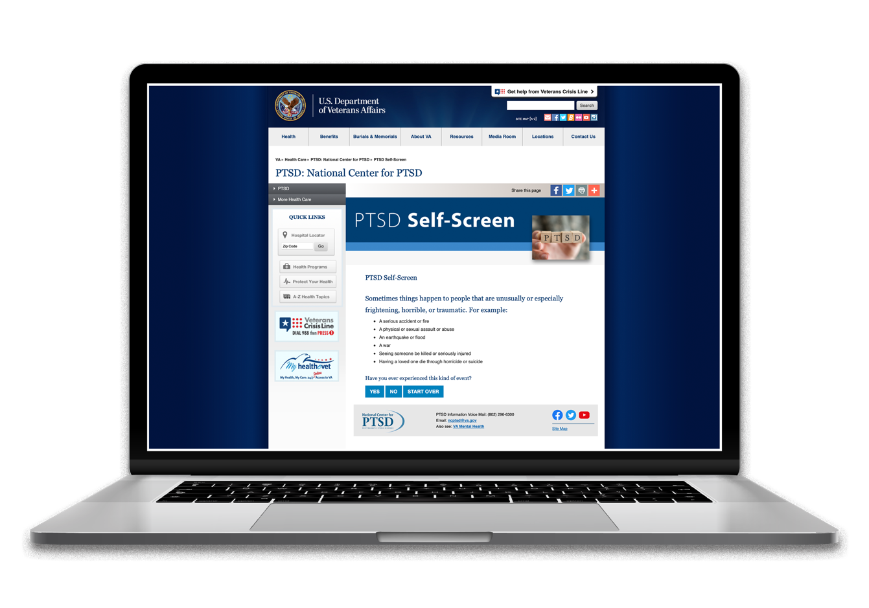
Primary Care PTSD Screen
Learn more at: https:www.ptsd.va.gov/screen/
View the YouTube video PTSD Screening
Notes:
There is a short, 5-item, brief screen that can help determine if the symptoms someone has could be related to PTSD. It is called the Primary Care PTSD Screen and is available on the National Center for PTSD website. Only a mental health provider can confirm that someone has PTSD, but this brief screening questionnaire is a good place to start.
Optional video: PTSD Screening

Slide 25
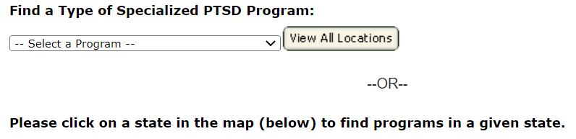
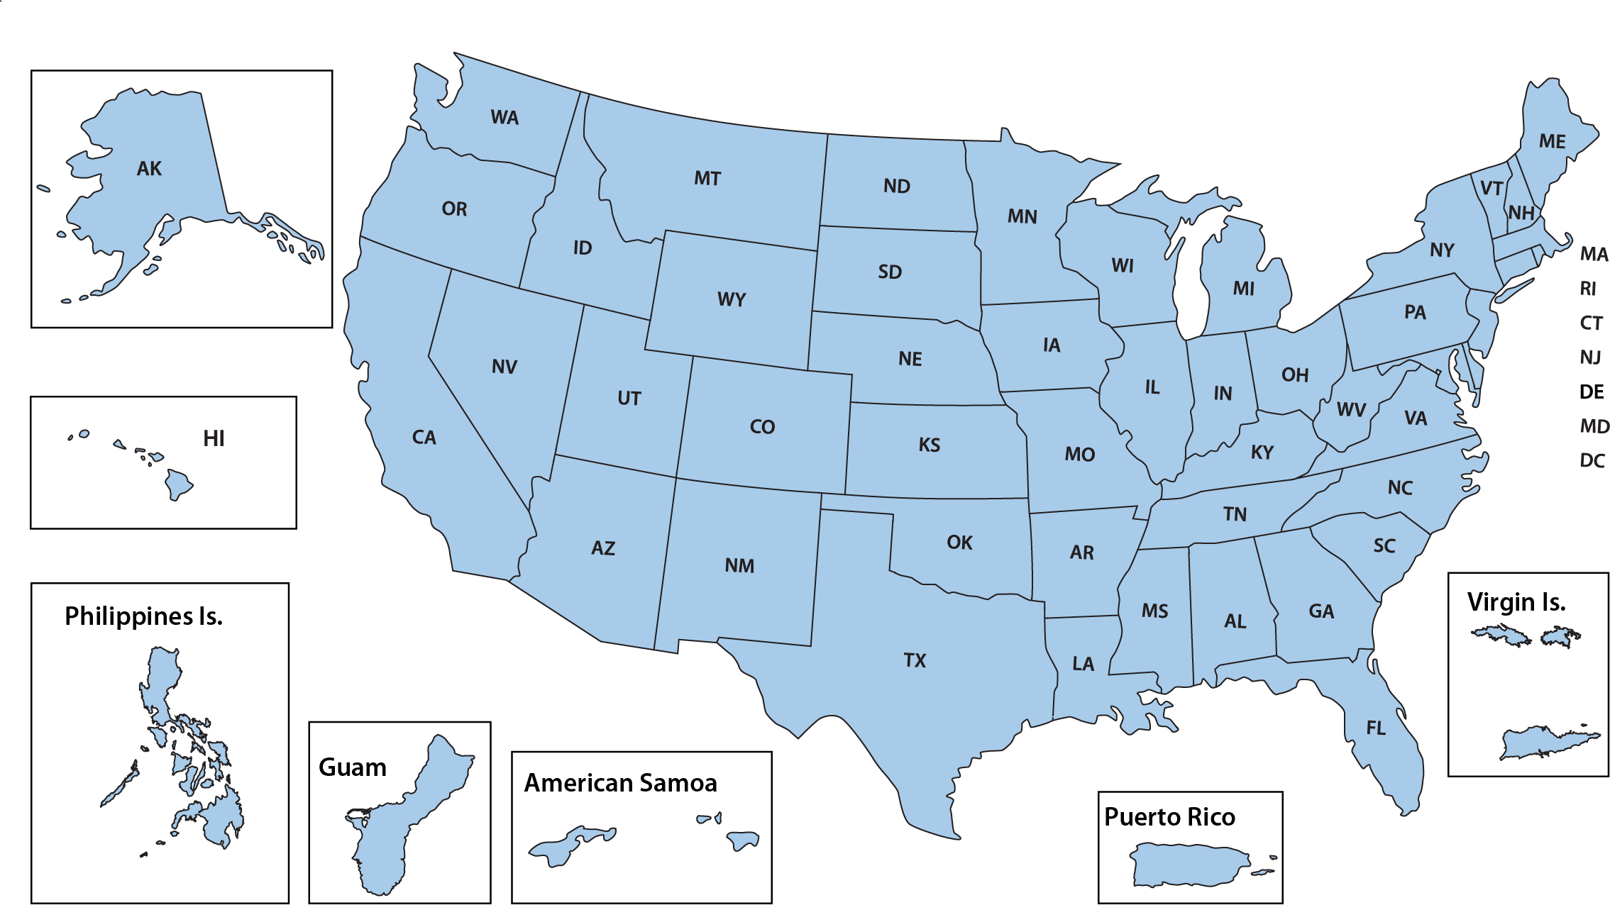

Finding a Provider
Find a provider:
https://www.ptsd.va.gov/gethelp/find_therapist.asp
Find a program: https://www.va.gov/directory/guide/PTSD.asp
Notes:
The next step is talking to a mental health professional. That can be done through a referral from a medical provider or by contacting a mental health provider directly.
This map makes it easy for Veterans who get can in VA to locate specialized PTSD programs. Every VA medical center offers PTSD treatment, even if there is not a specialized program.
In the community, it may be more challenging to find a provider, but organizations focusing on specific trauma-focused treatments also have online treatment locators. These resources are listed on the National Center for PTSD “Find a Provider” page.

Slide 26

Signs of Good PTSD Care
Learn more at https://www.ptsd.va.gov/understand_tx/tx_good_care.asp
Notes:
People who are in treatment for PTSD may wonder how to tell if they are receiving quality care. Here are four sings of good PTSD care to look out for: Patient involvement, following a proven treatment, measuring improvement and getting better. The National Center for PTSD article, “Signs of Good PTSD Care” provides a good overview of these four important signs.

Slide 27

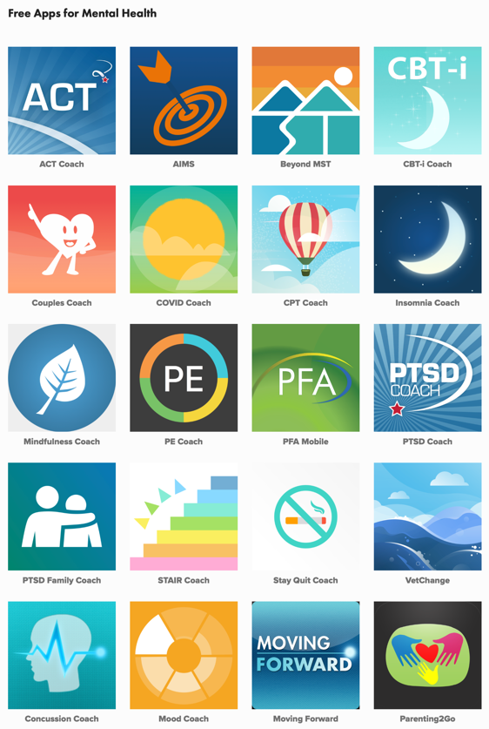

NCPTSD Apps: Help on the Go
Learn more at: https://myvaapps.com/
Option one: Introduction to VA mental health apps
Option two: YouTube Introduction to the PTSD Coach app
Option three: YouTube COVID Coach app demo
Notes:
The National Center for PTSD has also developed a host of apps that can help people with PTSD or anyone who is dealing with difficult emotions that may arise after trauma. These apps are not treatment, but they provide tools that can help people cope with stress, insomnia, depression, and anxiety.
[Optional videos
Option one: This video tells you more about the suite of apps the National Center for PTSD offers.]
Option two: Here’s a video that describes one of the National Center for PTSD’s most popular apps: PTSD Coach.
Option three: COVID Coach was created to support self-care and overall mental health during the COVID-19 pandemic.
There are additional App demo videos
that you can choose to show.]

Slide 28
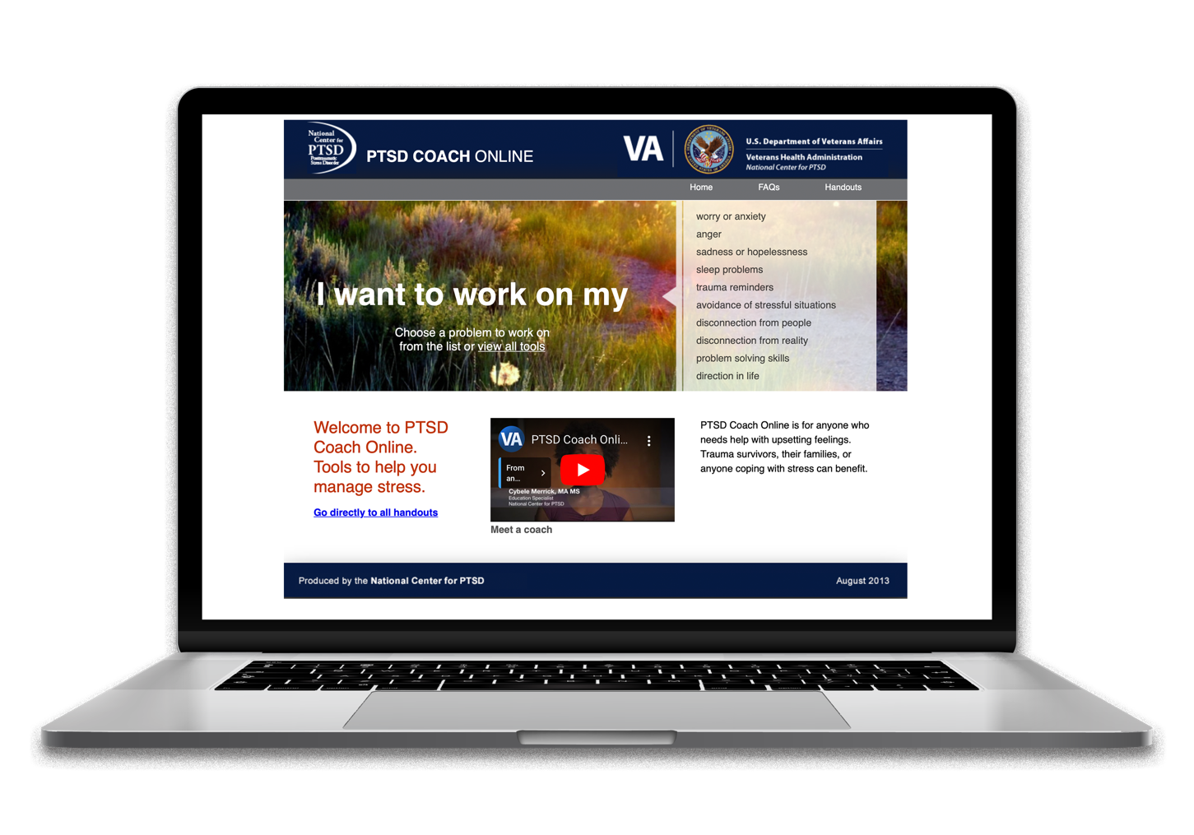
PTSD Coach Online
Learn more at: https://www.ptsd.va.gov/apps/ptsdcoachonline/default.htm
Notes:
There is also a desktop version of PTSD Coach. This resource – called PTSD Coach Online – contains many of the tools in the app, but also has more in-depth modules that focus on assertiveness, problem-solving, and goal setting. The desktop version also has worksheets that users can print out and complete by hand.

Slide 29
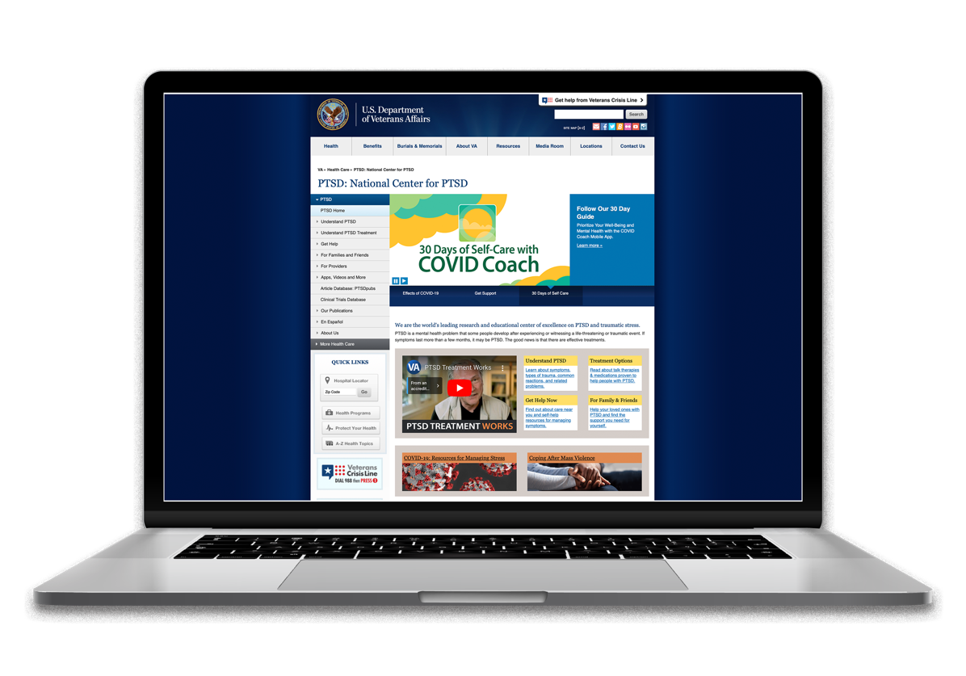
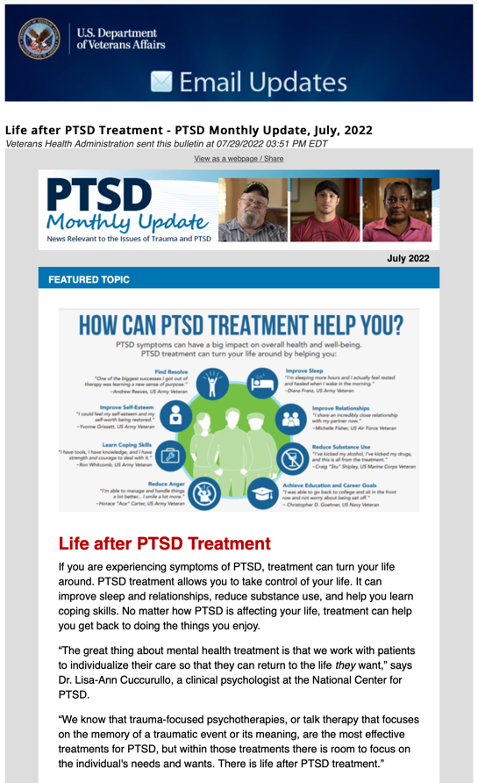


Stay Connected and Up-to-Date
Subscribe to updates at PTSD: National Center for PTSD (va.gov)
Notes:
The National Center for PTSD is a great resource for learning more about PTSD and PTSD treatment. You can sign up for the Monthly Update, connect with NCPTSD via Facebook and Twitter, and also visit the website at ptsd.va.gov.

Slide 30
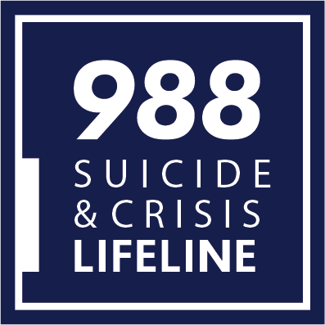

Need Help in a Crisis?
Notes:
If you or someone you love needs immediate help or is in crisis, please reach out to the Suicide & Crisis Lifeline or Veterans Crisis Line. Both are available at the same nationwide toll-free number: 988. Veterans can press “1” to reach the dedicated Veterans Crisis Line.

Slide 31
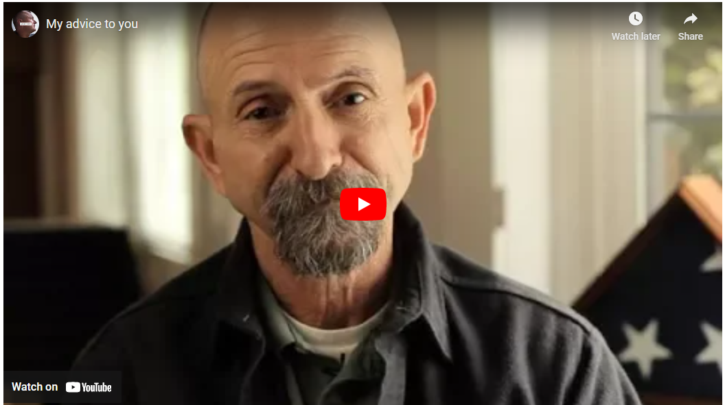
Veterans’ Advice to You
View the YouTube video My Advice to You
Notes:
Optional video:
Finally, hear Veterans on AboutFace share their advice for others who may be struggling with PTSD.

Slide 32

For Providers: PTSD Basics
Notes:
This section offers an overview of products and tools most useful for those who assess and treat PTSD.

Slide 33
Trauma is Common
Notes:
Worldwide, about 70% of people experience a traumatic event in their lifetimes. Many have experienced more than one. That means that most of the people you meet every day have probably experienced a trauma at some point
While the experience of trauma is widespread, some groups of people are more likely to experience it. Veterans, people who are members of the LGBTQ+ community, people experiencing poverty, and Black, Indigenous, and people of color (BIPOC) individuals are more likely to have a traumatic event happen to them.

Slide 34
What is Traumatic Stress?
Daily hassles can include a car breaking down or doing chores.
Major life events can include losing a job, divorce, buying a new home or getting married.
Serious traumatic events can include war zone exposure, physical or sexual assault, serious accidents, child sexual or physical abuse, mass violence, hate crimes, or disasters.
Notes:
PTSD is an interesting psychological phenomenon because it has a known etiology: a traumatic event. There are different kinds of stressful events. We all experience stressors every day. There are the daily hassles – things like the car breaking down or paying bills. Then there are larger, stressful events like losing a job or getting a divorce. Even good things like buying a home or getting married fall into this category.
Traumatic stressors or traumas are qualitatively different. A traumatic event is one in which the person feels that their life or the lives of others are being threatened. Examples include warzone exposure, physical or sexual assault, serious accidents, natural disasters, child sexual or physical abuse, mass violence, disasters and torture.

Slide 35
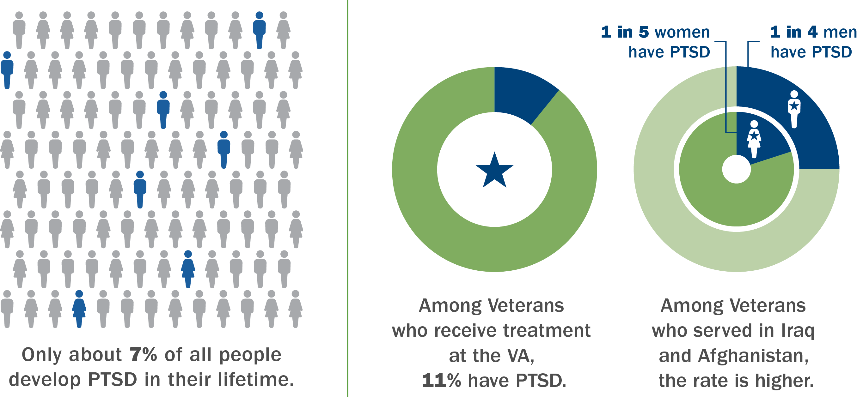
How Common is PTSD?
Source: Kreesler, R.C. Sonnega, A., Bromet, E., Hughes, M., & Nelson, C.B. (1995). Posttraumatic stress disorder in the national comorbidity survey. Archives of General Psychiatry, 52(12), 1048-1060
Notes:
Of those who experience trauma, most do not develop PTSD. Only 7% of all people develop PTSD in their lifetime.
Among Veterans who receive treatment at the VA, 11% have PTSD. However, the most recent estimates suggest that among Veterans who served in Iraq and Afghanistan, and who use VA care, the rate is higher. In this population, it is estimated that one in four men and one in five women have PTSD.

Slide 36

Criterion A: Traumatic Event
Directly experiencing a traumatic event
Witnessing, in person, an event that happened to someone else
Learning about the violent or unexpected death of a friend of family member
Experiencing repeated or extreme exposure to aversive details of
traumatic events
Notes:
According to the Diagnostic and Statistical Manual of Mental Disorders, or DSM-5, a diagnosis of PTSD requires one of the following specific types of trauma exposure to meet criteria A, which is the initial diagnostic criteria.
Directly experiencing a traumatic event such as being in combat or a hurricane.
Witnessing an event that happened to someone else such as seeing a serious car accident.
Learning about a traumatic event that happened to friends or family, such as learning about the homicide or suicide of a family member. (Having a family member die of natural causes does not qualify).
Or experiencing repeated or extreme exposure to aversive details of traumatic events such as collecting human remains after combat or a terrorist attack.
The DSM-5 is explicit that choosing to view media images on TV such as watching coverage of the 9/11 attacks on television does not lead to PTSD.

Slide 37
Military Sexual Trauma
MST is sexual assault or repeated, threatening sexual harassment that occurred during military service.
MST is an experience, not a diagnosis.
Notes:
Military sexual trauma, or MST, is the term used by the Department of Veterans Affairs (VA) to refer to experiences of sexual assault or repeated, threatening sexual harassment that occurred during their military service.
MST can occur while someone is on or off duty, or on or off base. Perpetrators of MST can be anyone—for example, they can be of any gender, and can be military personnel or civilians, superiors or subordinates in the chain of command, strangers, friends or intimate partners.
MST is an experience, not a diagnosis or a mental health condition. As with other forms of trauma, there are a variety of reactions that Veterans can have in response to MST.
Although PTSD is one of the most common mental health diagnoses among individuals who experienced MST, not everyone who experiences MST will go on to develop PTSD.

Slide 38
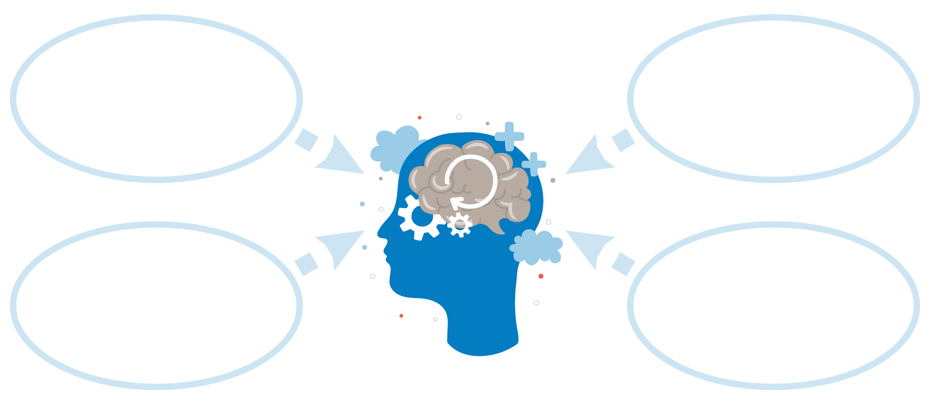
Symptom Clusters I
At least 1 Intrusion symptom
At least 1 Avoidance symptom
At least 2 Negative alterations in cognitions and mood
At least 2 Arousal and reactivity symptom
Notes:
In addition to trauma exposure, a diagnosis of PTSD requires a combination of symptoms from specific symptom clusters: Intrusion, Avoidance, Negative alterations in cognition or mood, and Hyperarousal.
These symptoms must be present for more than one month and must cause significant distress or impairment.

Slide 39
Symptom Clusters (II)
Intrusion ( “flashbacks”)
  Recurrent distressing dreams or memories of the event; acting/feeling as if the event is happening again
Avoidance
  Avoiding memories, thoughts, feelings, people, places or activities that are reminders of the event
Notes:
People with PTSD re-experience the trauma. A diagnosis of PTSD requires at least one intrusion symptom. These include intrusive thoughts about the trauma, nightmares or flashbacks of the event where it feels like it's happening again or becoming emotionally or physically upset by reminders of the trauma. For example, because bridges are dangerous in Iraq, an Iraq Veteran might feel nervous and have a racing heart when driving under a bridge. Or someone who was present during a mass shooting might have reminders when in crowds.
People with PTSD also need to have at least one avoidance symptom which can include avoidance of thinking about the trauma, or avoiding people, places, or activities that remind them of the trauma. For example, people with PTSD will often avoid crowds because they feel unsafe. Motor vehicle accident survivors might avoid driving. And hurricane survivors might avoid going outside in bad weather.

Slide 40
Symptom Clusters (III)
Negative alterations in cognitions and mood
  Inability to recall parts of the trauma, diminished interest in activities, feeling detached, inability to feel positive emotions, negative emotions, distorted blame of self or others, exaggerated negative beliefs or expectations
Arousal and reactivity symptoms
  Irritable behavior, outbursts of anger, reckless or self-destructive behavior, problems concentrating, hypervigilance, exaggerated startle, sleep disturbance
Notes:
People with PTSD also have negative thoughts and feelings that get worse after the trauma. The diagnosis requires at least two symptoms from this cluster. These symptoms include an inability to recall important aspects of the trauma, decreased interest or pleasure in activities, such as not enjoying social events, feeling detached from people, and an inability to feel positive emotions like love or happiness.
Additionally, people with PTSD may have persistent negative beliefs about themselves, others, and the world. They may experience guilt or shame. And they might have distorted beliefs about the traumatic event.
It makes sense that people with PTSD often feel wound up or in a state of hyperarousal. Even though the trauma is in the past, with PTSD, people feel like they're still in danger; as a result, it's hard to relax. People with PTSD often have trouble sleeping. They can be irritable and have trouble concentrating. They're on guard and constantly scanning for danger. They may engage in reckless or risky behavior like driving too fast and they might startle easily. You need at least two arousal and reactivity symptoms for a diagnosis.

Slide 41
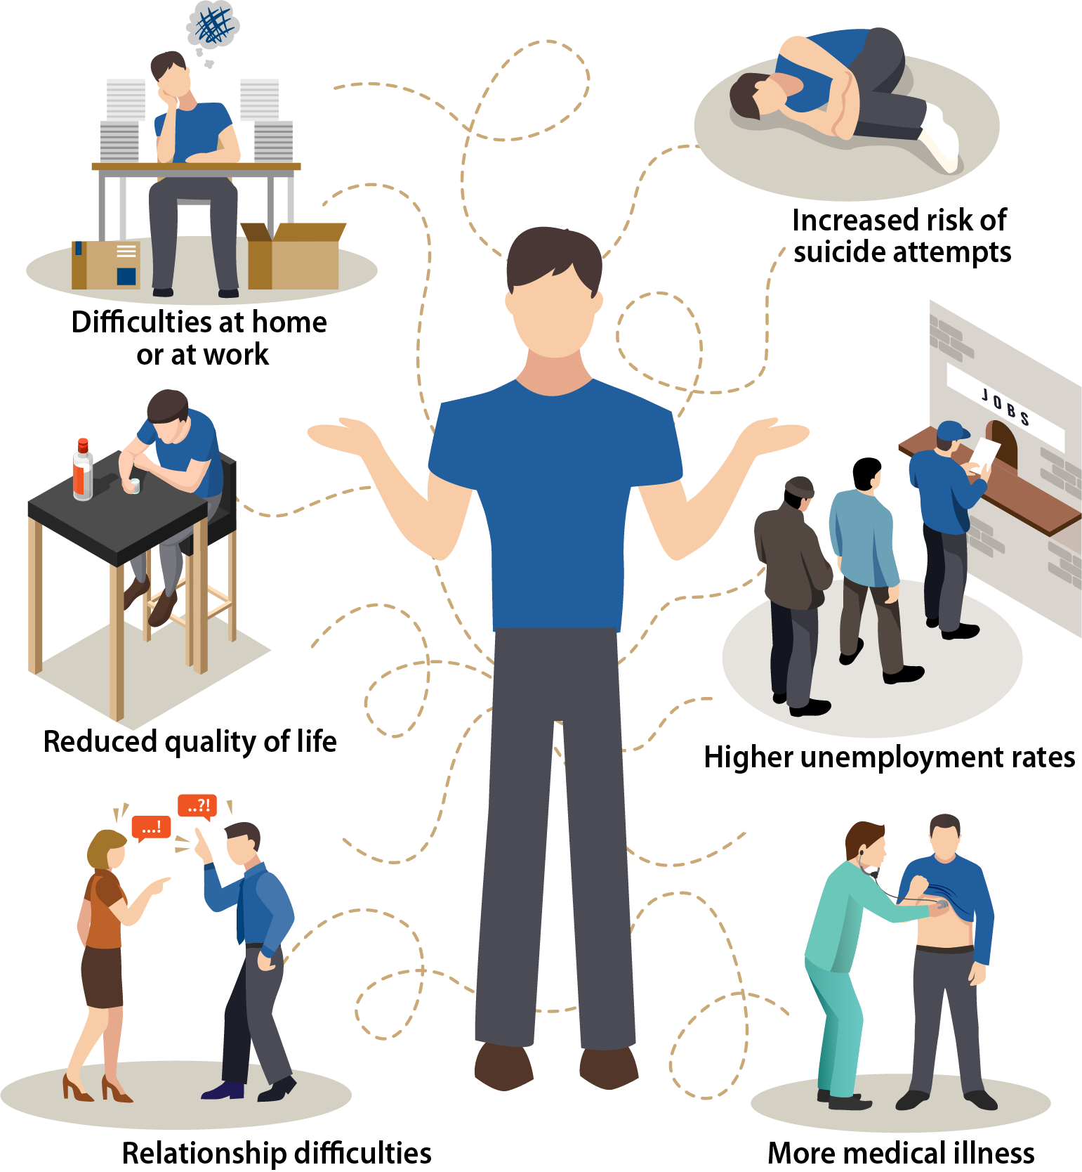
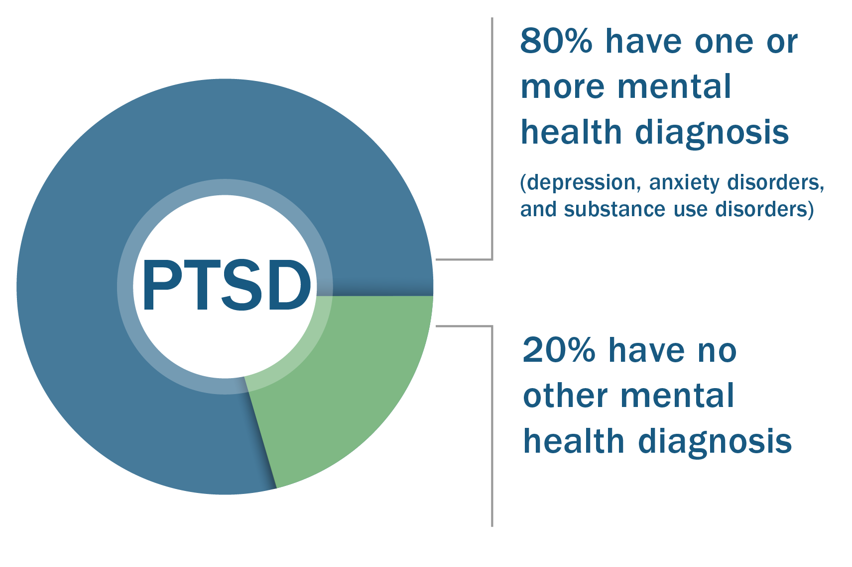
Other Co-Occurring Problems
Notes:
About 80% of people with PTSD have another mental health diagnosis, and many have more than one. Among the most common co-occurring disorders are depression, anxiety, and substance use disorders.
People with PTSD are more likely to have greater functional impairment and a reduced quality of life. Concentration problems, irritability and avoidance can cause trouble at work and can result in higher unemployment rates. The numbing and avoidance symptoms make it hard for people with PTSD to maintain close relationships and some may engage in interpersonal violence. Research also shows that being in a state of chronic stress and arousal results in a wide range of medical problems. And finally, PTSD is a risk factor for suicide.

Slide 42

For Providers:
Screening, Assessment, And Treatment

Slide 43

Screening for PTSD
Notes:
Given the toll that PTSD can take on people’s lives, it’s important to screen for the disorder and provide treatment for those who have it. Screening instruments vary in both breadth and depth. Although most assess current DSM symptoms, others include associated trauma symptoms.

Slide 44
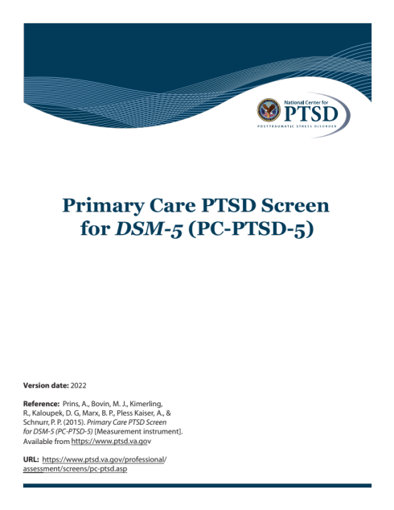
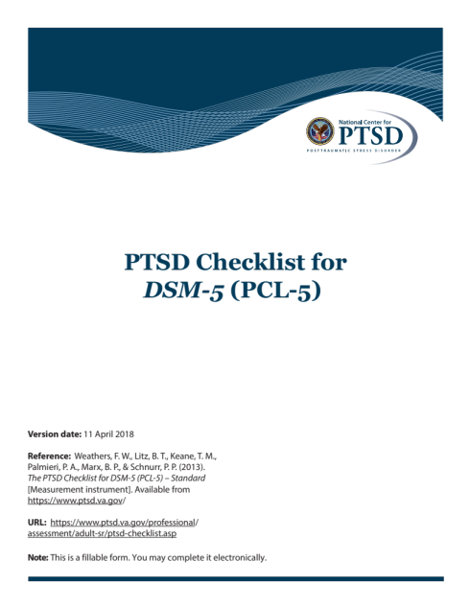
Recommended Screening Instruments
Primary Care PTSD Screen
PTSD Checklist
https://www.ptsd.va.gov/professional/assessment/screens/pc-ptsd.asp
https://www.ptsd.va.gov/professional/assessment/adult-sr/ptsd-checklist.asp
Notes:
The Primary Care PTSD Screen and the PTSD Checklist – both developed by the National Center for PTSD – are excellent PTSD screening instruments.

Slide 45
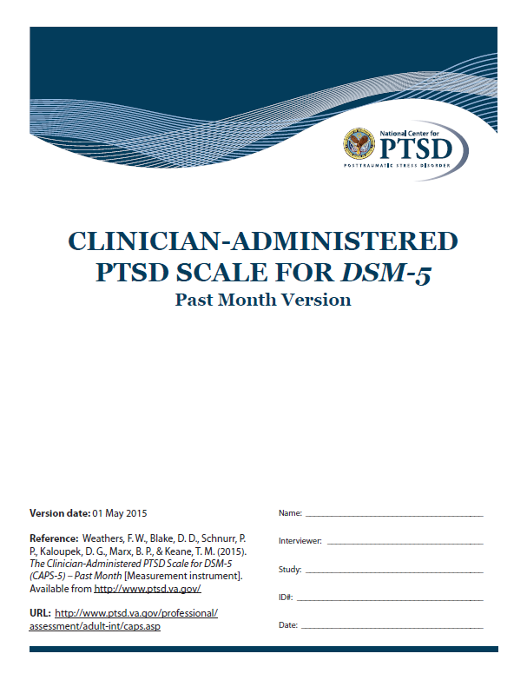
PTSD Assessment
View the assessment at https://www.ptsd.va.gov/professional/assessment/adult-int/caps.asp
Notes:
For those who screen positive, the next step is a full assessment to confirm the diagnosis. A clinician should never make a diagnosis of PTSD based solely on a screen.
The Clinician Administered PTSD Scale for DSM-5, or the CAPS-5, is the gold standard in PTSD assessment.
It is a thirty-item interview developed by the National Center for PTSD that assesses traumatic exposure as well as all the other core symptoms of the DSM-5 diagnosis for PTSD. It also assesses for associated features, including disassociation.

Slide 46
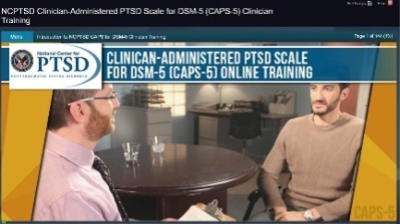
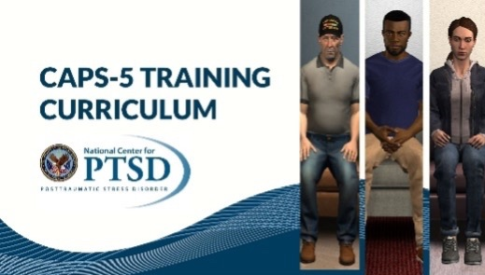
CAPS-5 Online Training Curriculum
View the Training Curriculum at https://www.ptsd.va.gov/professional/continuing_ed/caps5_clinician_training.asp
View the CAPS-5 promo video
Notes:
The National Center for PTSD has developed a four-course curriculum on the CAPS-5. The first course explains the history, rationale, administration and scoring of the measure. It culminates in a video that allows learners to score along as an expert administers the measure to a mock patient.
In Parts 2 – 4 of the curriculum, learners administer the CAPS-5 to a virtual patient who responds to prompts and questions in real time.
[Optional video]

Slide 47
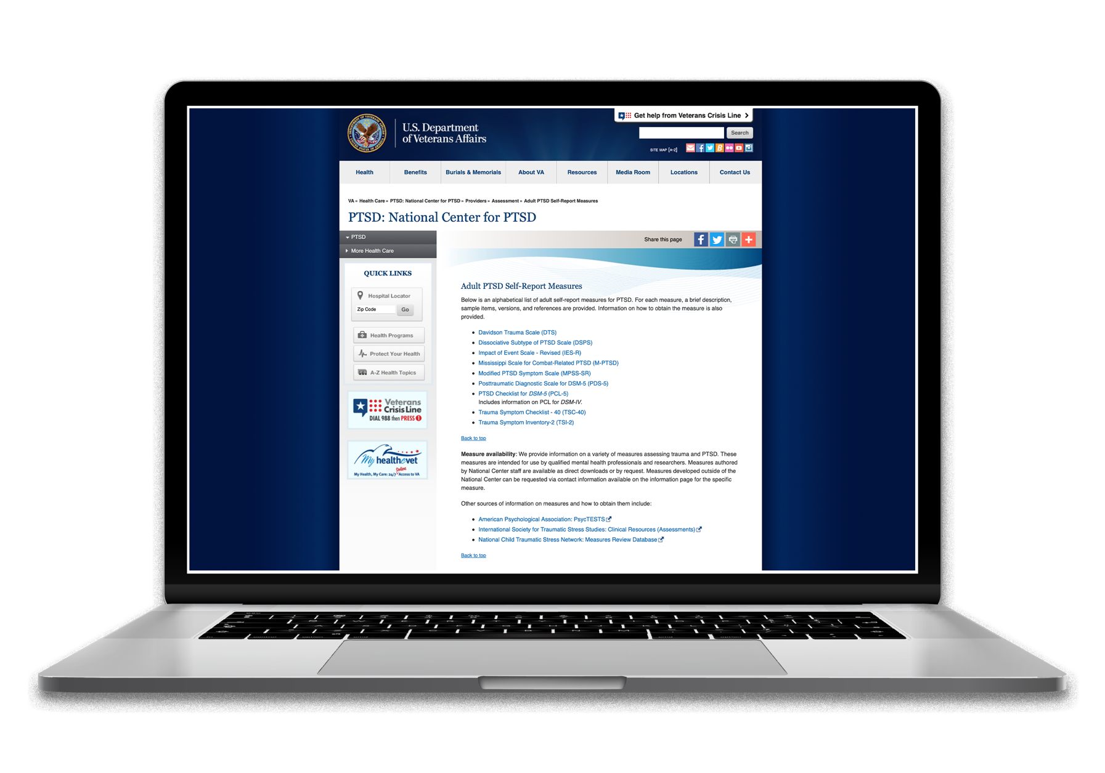
Screening and Assessment Information & Tools
Assessment section: https://www.ptsd.va.gov/PTSD/professional/assessment/index.asp
NCPTSD instruments: https://www.ptsd.va.gov/professional/assessment/list_measures.asp - list1
Notes:
While the CAPS-5 is considered the gold standard for PTSD assessment, there are other measures available. The PTSD Symptom Scale Interview, or PSSI; the Structured Interview for PTSD, or SIP; the PTSD Interview; and the PTSD Module from the Structured Clinical Interview for the DSM, or SCID can all be used to diagnose PTSD.
The National Center for PTSD website provides comprehensive information on screening and assessment, including downloadable versions of instruments developed by the National Center for PTSD.

Slide 48

Treatment for PTSD
Notes:
Turning to treatment, the good news is that PTSD is treatable and there are a wide range of options to choose from. Treatment for PTSD – in the form of trauma-focused therapy – gives a person the best chance of recovery. Other therapies and certain medications can also be effective. Let’s look at these options.

Slide 49
Trauma-focused therapy is most effective.
Prolonged Exposure Therapy
Cognitive Processing Therapy
Eye Movement Desensitization and Reprocessing (EMDR)
Notes:
The most effective therapies are Prolonged Exposure Therapy, Cognitive Processing Therapy, and Eye Movement Desensitization and Reprocessing – or EMDR. These are all trauma-focused therapies, in which attention to the trauma is a central focus of the treatment.

Slide 50
Trauma-focused Psychotherapies
Prolonged Exposure Therapy - The patient confronts situations they had been avoiding until distress decreases
Cognitive Processing Therapy – The patient examines and challenges thoughts and feelings about the trauma
Eye Movement Desensitization and Reprocessing (EMDR) – The patient processes and makes sense of the trauma while paying attention to a back-and-forth movement or sound
Notes:
Prolonged exposure, or PE, involves repeated exposure to thoughts, feelings, and situations that the trauma survivor has been avoiding. Engaging in this exposure helps the person learn that the reminders of the trauma don't have to be avoided. There are four main components. PE begins with education about the symptoms of PTSD to help clients better understand their symptoms, and then breathing retraining is taught to help clients manage anxiety. Exposure---the key component of PE---comes next. In in vivo exposure, or live exposure, the client identifies situations that they've been avoiding and repeatedly confronts or goes into those situations until their distress decreases. Then the client begins imaginal exposure to the trauma: they retell the trauma in the present tense with as much detail as possible until they can essentially describe or recall the trauma without becoming distressed.
In Cognitive Processing Therapy the focus is on examining and changing trauma related thoughts --- called stuck points --- that may be keeping the client from moving on from the trauma. Like PE, it begins with education about the symptoms of PTSD. The second step involves processing the trauma, which can be done with or without a written account of the trauma. In this step the client is asked to reflect on having made sense of what happened at the time of the trauma. In the third step of CPT the client learns cognitive skills to challenge thoughts, such as, "It was all my fault," or "The world is completely unsafe.” In the fourth step the client uses those skills to challenge and modify their cognitions with the goal of taking a new, more balanced perspective.
There are eight phases of EMDR. As with PE and CPT, EMDR begins with history taking and education. Phase two is focused on preparing the client for treatment and providing treatment rationale. In phase three the client identifies an image from the target trauma and then the client identifies a negative trauma-related cognition and a positive cognition that they hope to replace it with. Phases four to seven focus on processing the memory to adaptive resolution. The client visualizes the trauma memory and the negative cognition while the therapist leads them through bilateral stimulations such as eye movement. This is where desensitization and reprocessing occur. Body scanning is then used to determine if any unpleasant bodily sensations remain associated with the event. Once distress is reduced and the more adaptive cognition feels true to the patient, the therapist and client decide whether to move on to another target memory. In phase eight, the treatment response is evaluated.

Slide 51
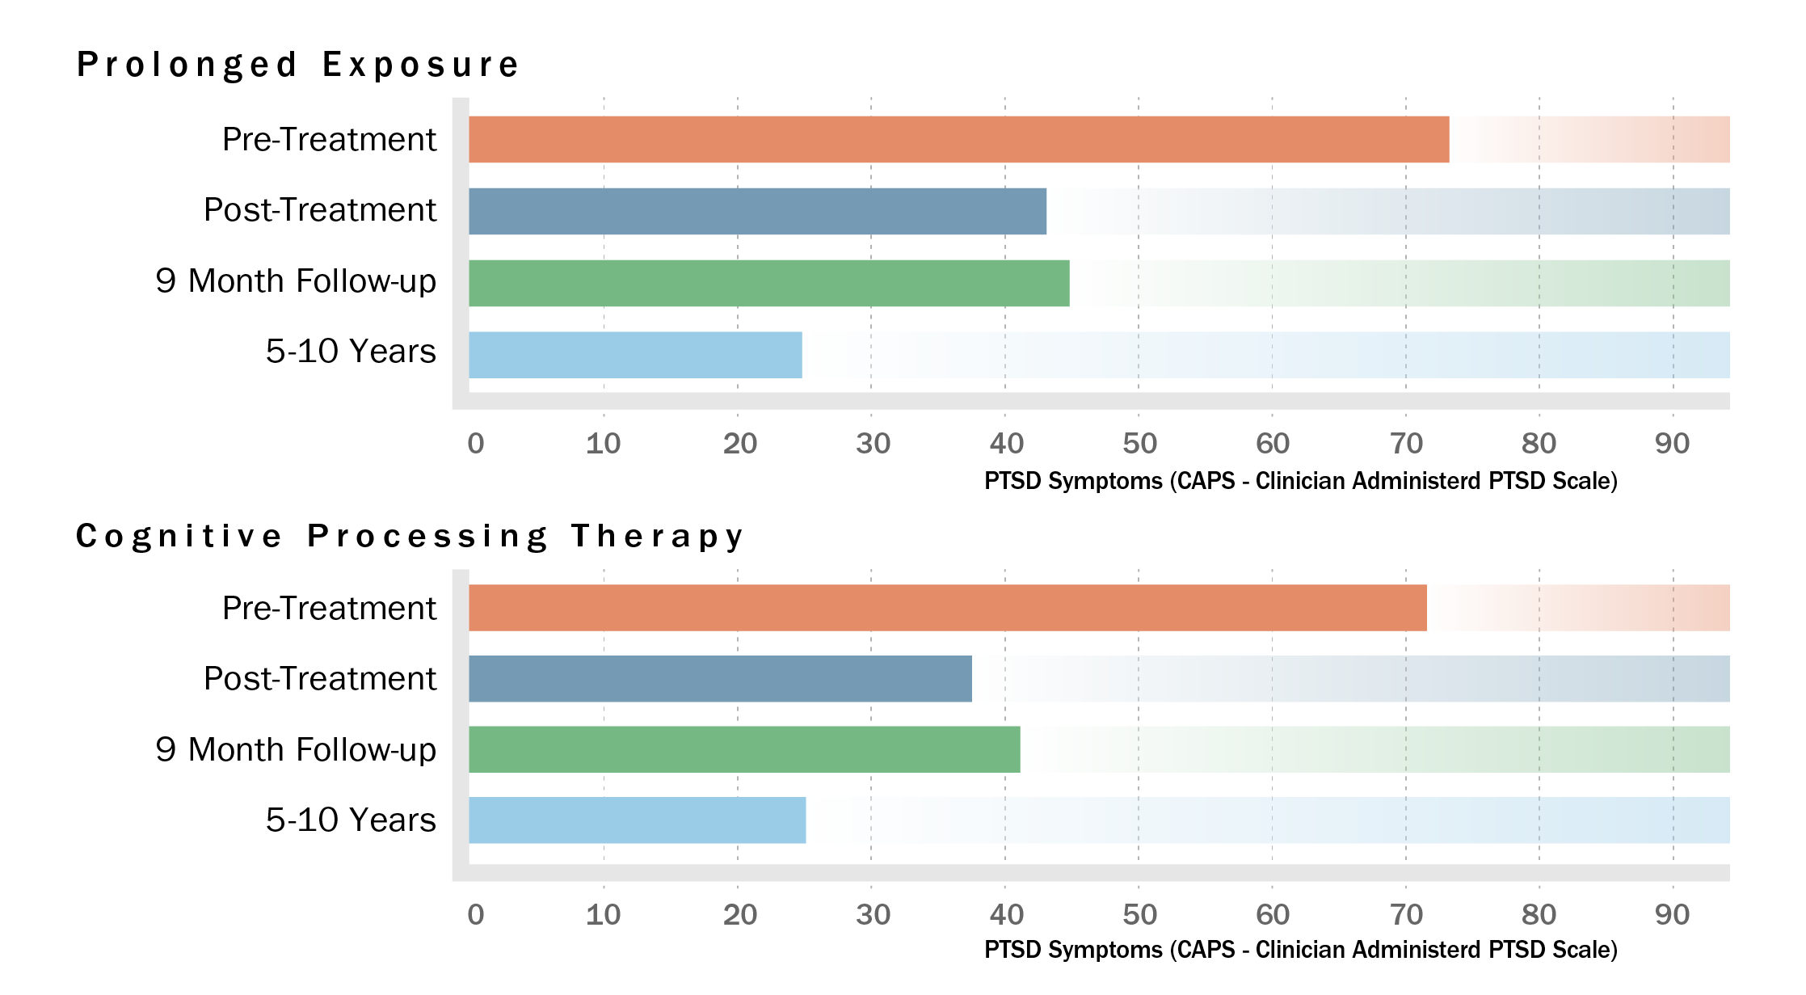
Trauma-focused psychotherapy works.
Resick, Patricia A: Nishith, Pallavi: Weaver, Terri L: Astin, Millie C.: Feuer, Catherine A. Journal of Consulting and Clinical Psychology, Vol 70(4), Aug 2002, 867-879. doi: 10.1037/0022-006X.70.4.867
Notes:
The Clinician-Administered PTSD Scale --- the CAPS --- is our gold standard for measuring PTSD. A CAPS in the 70s would be considered severe PTSD for the CAPS-4 which is what you see here. Both Prolonged Exposure and Cognitive Processing Therapy result in very large changes on the CAPS that are maintained at post-treatment and 9-month follow up. But even more exciting is that when the researchers went back five to ten years later to check on these people, and a few new people who had enrolled since the study had started, the results looked even better. CAPS scores continued to drop to about 25 which is the mild or sub-threshold range. About 80% of study participants no longer met criteria for PTSD.

Slide 52
Other Psychotherapies
Written Exposure Therapy – The patient writes about their trauma with the guidance and feedback of their therapist
Present Centered Therapy – The patient learns problem-solving skills to help them deal with stressors related to the trauma
Notes:
Besides Cognitive Processing Therapy, Prolonged Exposure, and EMDR, there are other therapies that offer good results for patients with PTSD. Even though they are not quite as effective, they can be a good choice.
Written Exposure Therapy, where patients write about their trauma with the guidance and feedback of their therapist, can be completed in 5 sessions.
Present-Centered Therapy focuses on problem solving, so it may be a good choice for patients who prefer a non-trauma-focused option.

Slide 53

Medications
Sertraline (Zoloft)
Venlafaxine (Effexor)
Notes:
The evidence is absolutely clear that psychotherapy is much more effective, at this point in time, than medications. But for patients who choose not to engage in or are unable to access trauma-focused psychotherapy, medication is certainly an option.
Sertraline – or Zoloft – and venlafaxine – also known as Effexor – work well to relieve the symptoms of PTSD.

Slide 54
What about Benzodiazepines?
Safety concerns
Limited value
Risk of addiction
Even more risky for older people
Benzodiazepines are NOT recommended for PTSD treatment.
Notes:
Though commonly prescribed for people with PTSD, benzodiazepines are not a good treatment for the disorder. Benzodiazepines present significant safety concerns including cognitive effects, risk of falls, and risk of addiction.

Slide 55
A Mind-Body Approach
Mind-body approaches to treatment are outside of conventional medical treatment that may be used in conjunction with, or in the place of, conventional medical treatment.
  Mindfulness-Based Stress Reduction (MBSR)
Notes:
Some patients may prefer a mind-body approach as an alternative to – or alongside – psychotherapy or medication. The most effective mind-body approach is Mindfulness-Based Stress Reduction.
MBSR trains people to focus attention on thoughts, sensations, and feelings as they appear and in a non-judgmental way. It incorporates techniques such as mindful yoga, body scans, meditation, and remaining mindful in daily life.

Slide 56

For Providers: Shared Decision-Making

Slide 57


Shared Decision-Making
Patient Preferences for Decision-Making
24% Active
44% Active-Shared
23% Collaborative
6% Passive-Shared
3% Passive
Survey of 301 adults with PTSD symptoms: Harik and colleagues, 2016
Notes:
Shared decision-making – a model of patient-centered care that enables and encourages people to play a role in the medical decisions that affect their health – should be a part of treatment planning. Research conducted by National Center for PTSD researchers found that the majority of patients want to take a collaborative or active role in deciding on the treatment they receive.

Slide 58
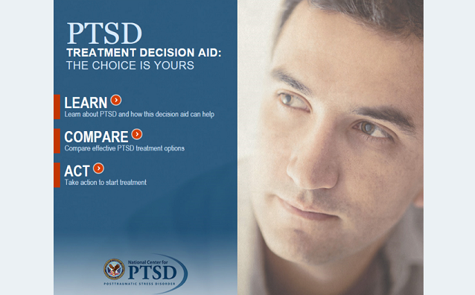
PTSD Treatment Decision Aid
Decision Aid:
https://www.ptsd.va.gov/apps/decisionaid/
User guide: https://www.ptsd.va.gov/apps/decisionaid/
resources/PTSDDecisionAid_providerguide.pdf
Course:
https://www.ptsd.va.gov/professional/
continuing_ed/shared_decision_making.asp
Notes:
The PTSD Treatment Decision Aid, developed by the National Center for PTSD, can be a component of the shared decision-making process. The accompanying Clinician’s User guide offers tips on using the PTSD Treatment Decision Aid with patients. The National Center for PTSD also has a course on how to use shared decision-making with patients with PTSD.

Slide 59

AboutFace
View AboutFace at: https://www.ptsd.va.gov/apps/AboutFace/
Notes:
Another tool that providers can use with patients in treatment planning is AboutFace. This site has hundreds of videos of Veterans, family members, and providers talking about PTSD and how treatment can help. There is a guide for clinicians that gives providers tips on using AboutFace with patients and also one for peer specialists.
Users can explore AboutFace in two ways: by moving through the site topic by topic starting with “What is PTSD?” or by watching videos that they can select based on criteria like a Veteran’s service era or branch of service, type of treatment, or common concerns like sleep or relationships.

Slide 60
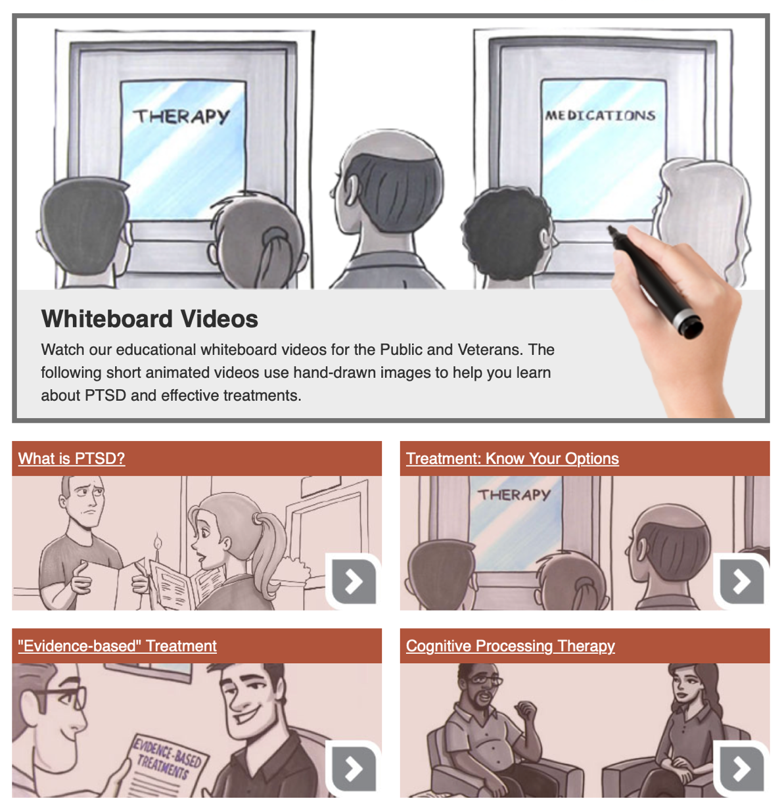
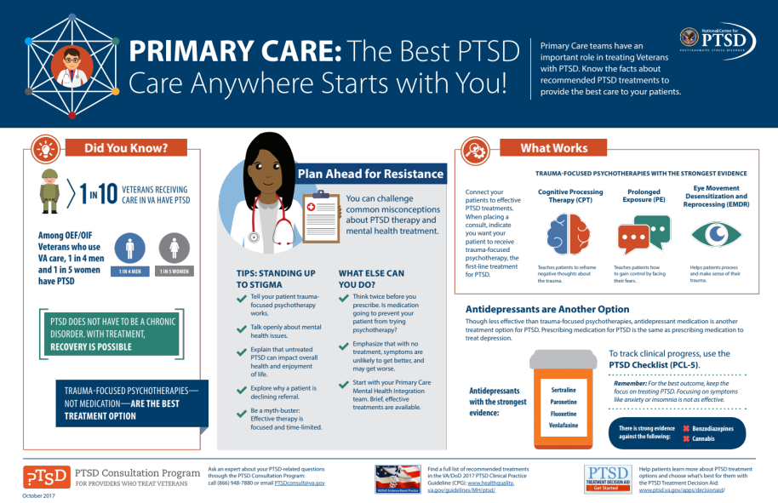
Patient Engagement and Education
Find videos at: https://www.ptsd.va.gov/appvid/video/index.asp
Find print materials at: https://www.ptsd.va.gov/publications/print/index.asp
Notes:
The National Center for PTSD also offers animated videos that providers can share with patients. These videos -- each clocking in at less than 4 minutes – explain evidence-based PTSD treatment in a way that is easy to understand.
Providers can also share brochures from the National Center for PTSD, either electronically, or in print. Free copies of a wide array of pamphlets and brochures can be ordered for free via the National Center for PTSD website.

Slide 61









PTSD Consultation Program for Providers who Treat Veterans
About the Consultants
Experienced senior psychologists, psychiatrists, social workers, pharmacists, and other health professionals who treat Veterans with PTSD
Available to consult on everything from your toughest cases to general PTSD questions
Ask about:
Evidence-based treatment
Medications
Clinical management
Resources
Assessment
Referrals
Collaborating with VA on Veterans’ care
Developing a PTSD treatment program
Available Resources - www.ptsd.va.gov/consult
Free continuing education
Videos, educational handouts, and manuals
PTSD-related publications
PTSD and trauma assessment and screening tools
Mobile apps, and more
WWW.PTSD.VA.GOV
Notes:
Questions about shared decision making, assessment, treatment – anything providers need help with related to PTSD in Veterans – can be directed to the PTSD Consultation Program. No question is too big or too small.
The PTSD Consultation Program also offers continuing education – including a monthly lecture series – and other resources to healthcare providers who treat Veterans with PTSD in the community or in VA.
[Optional video:
This brief video explains how the program works.]

Slide 62
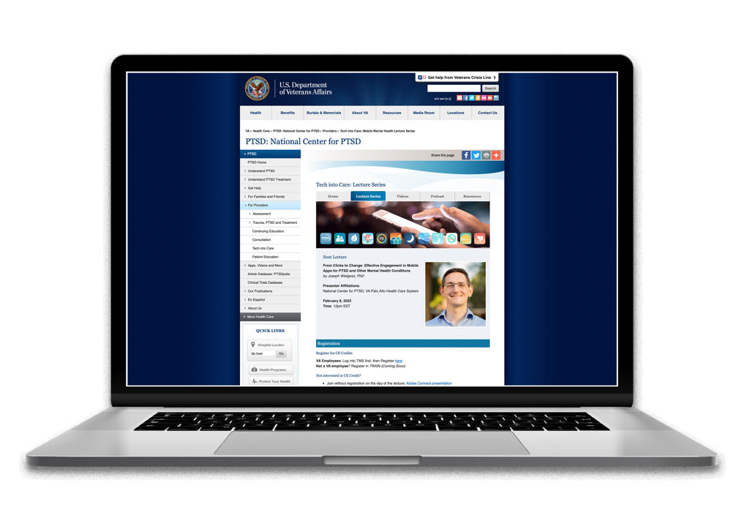

Tech into Care
Tech into care series: https://www.ptsd.va.gov/professional/tech-care/tech_lectures.asp
Instructional videos: https://www.ptsd.va.gov/professional/tech-care/videos.asp
Notes:
Another program that works with providers both in VA and in the community is Tech into Care. Tech into Care is an initiative open to providers interested in learning how to integrate technology into care for Veterans. The primary focus is on the suite of apps created by the National Center for PTSD.
Tech into Care hosts a monthly lecture series that anyone can attend. The program has also developed instructional videos on integrating apps into clinical care, including ones demonstrating apps on insomnia treatment and Prolonged Exposure Therapy.
[Option to show Introduction to VA mental health apps or another video]

Slide 63
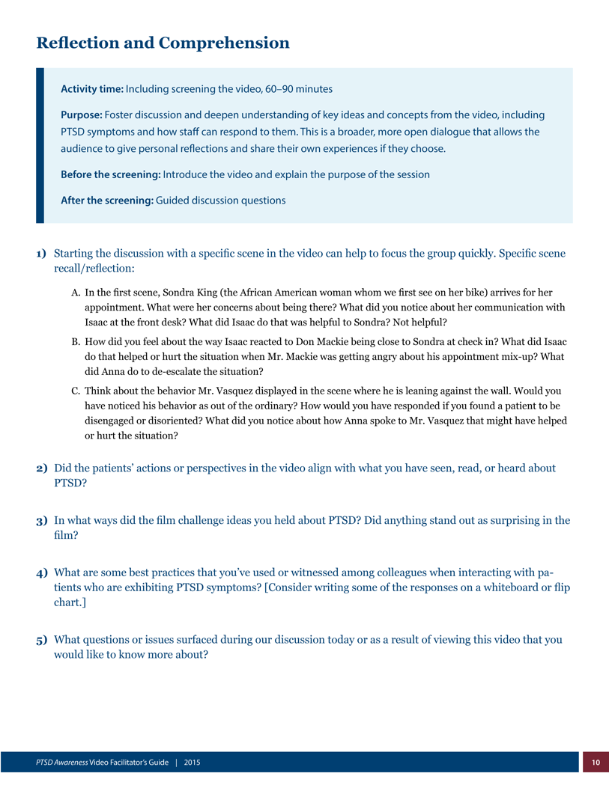
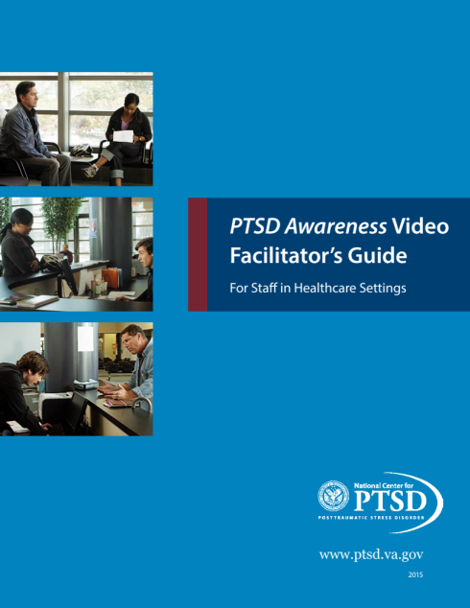
PTSD Awareness in Health Care Settings
Video:
https://www.ptsd.va.gov/appvid/video/pro_videos.asp
Guide:
https://www.ptsd.va.gov/appvid/video/docs/VAFacGuideStaffHealthcare.pdf
Notes:
Because Veterans and other people with PTSD and trauma histories have interactions in health care settings outside the exam room, the National Center for PTSD created a video called PTSD Awareness in Health Care Settings. This 15-minute video presents the experience of three Veteran characters in a busy hospital setting, showing how patients’ PTSD symptoms may come into play in their encounters with staff.
An accompanying Facilitator's Guide gives suggestions for how managers and trainers can use PTSD Awareness in Healthcare Settings as part of employee training sessions. While the video is in a VA clinic, it is applicable to all healthcare settings.

Slide 64
Trauma-informed Care
Community Provider Toolkit
Clergy Toolkit
Police Officer Toolkit: PTSD and Military Veterans
VA College Toolkit
Veterans Employment Toolkit
Rural Provider PTSD Toolkit
Notes:
While the treatment of PTSD largely falls to the mental health system, professionals in other fields also interact with people with a history of trauma and PTSD. The National Center for PTSD has developed toolkits for professionals in many other settings.

Slide 65

Provider Education and Staying Up-to-Date

Slide 66
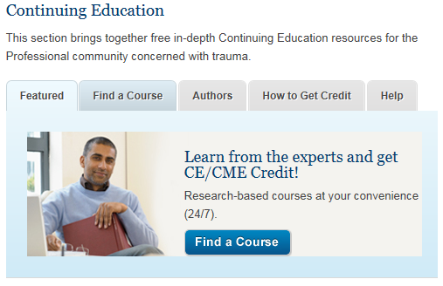
Continuing Education
Learn more about Continuing Education at: https://www.ptsd.va.gov/professional/continuing_ed/index.asp
Notes:
Free continuing education courses and recorded webinars developed by the National Center for PTSD address the treatment of co-occurring disorders and cover other aspects of PTSD assessment and treatment. New courses are added throughout the year, with over 60 currently available. Free continuing education credits in a variety of disciplines are available, and courses are open to providers in the community as well as in VA.

Slide 67
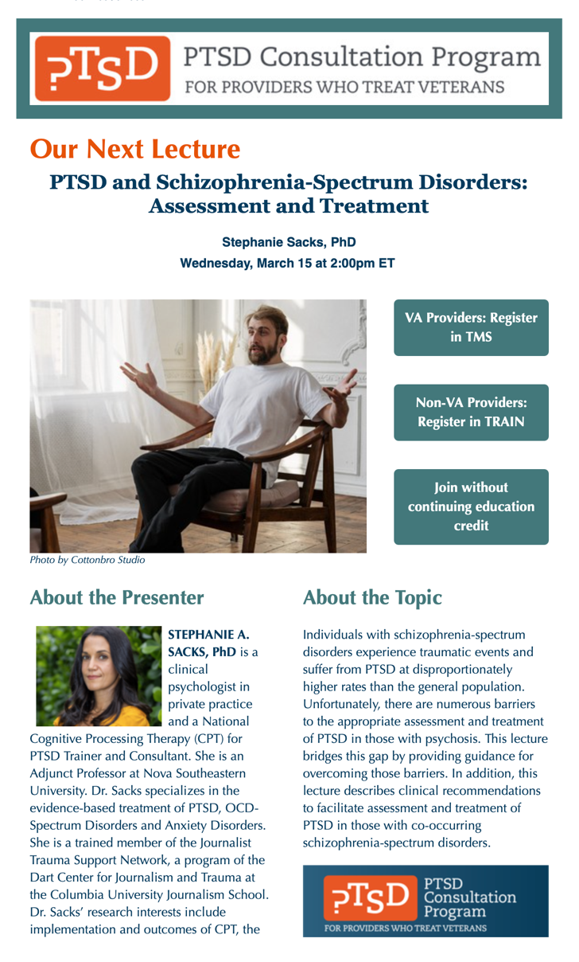
Stay Up-to-Date
Find electronic publications at: https://www.ptsd.va.gov/publications/electronic_pubs.asp
Notes:
Providers can also stay up to date with developments in PTSD treatment and research through the National Center for PTSD’s electronic publications.
Clinician’s Trauma Update Online has brief updates on clinically relevant research, especially around assessment and treatment. The Research Quarterly focuses on a single topic each episode, with in-depth review articles written by experts in the field.
The PTSD Consultation Program Newsletter, released each month, includes registration links for lecture series as well as articles and free resources relevant to treating Veterans with PTSD.

Slide 68

The PTSD Repository and PTSDpubs
PTSD-Repository: https://ptsd-va.data.socrata.com/
PTSDpubs: https://www.ptsd.va.gov/ptsdpubs/search_ptsdpubs.asp
Image credit: WOCinTechChat.com
Notes:
For those who want to dig deeper into research on PTSD treatment, the PTSD Trials Standardized Data Repository (PTSD-Repository) is a database that contains information pulled from almost 400 published randomized controlled trials of PTSD treatment.
While the PTSD-Repository pulls data from randomized controlled trials, PTSDpubs is a different kind of database. It indexes the world’s literature on PTSD and other mental health consequences of exposure to traumatic events. It covers articles, books and chapters from all disciplines from around the world. PDFs of National Center authored articles are freely available.

Slide 69

For Providers: Mass Trauma

Slide 70
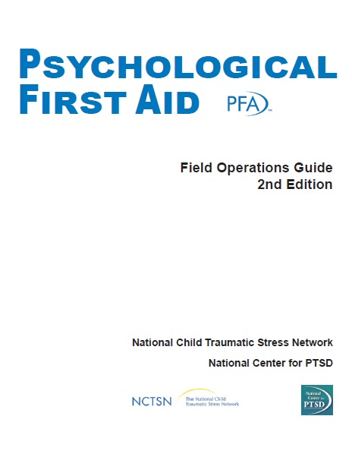
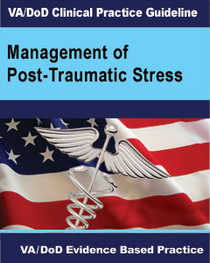
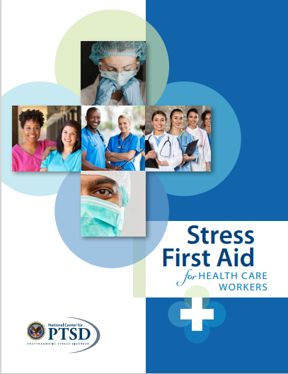

Coping with Mass Trauma
Notes:
Mass trauma events – in the form of violence and disasters – occur all too frequently. As in the case of individual traumas, providers are called on to provide support to people who have experienced them. And in many cases providers’ own lives are affected by these events.
The National Center for PTSD has tools and resources to help providers address both their clients’ needs and their own, including manuals for Psychological First Aid, Skills for Psychological Recovery, and Stress First Aid.
The PTSD Consultation Program also available to help ALL providers – whether their patients are Veterans or not – who have questions about treating survivors of mass trauma.

Slide 71
In conclusion…

Slide 72
The National Center for PTSD
Learn more at http://www.ptsd.va.gov/
Notes:
You can visit the National Center for PTSD’s website to access all these resources and more. As the world's leading research and educational center of excellence on PTSD and traumatic stress, the National Center for PTSD works to advance the clinical care and social welfare of America's Veterans and others who have experienced trauma, or who suffer from PTSD, through research, education, and training in the science, diagnosis, and treatment of PTSD and stress-related disorders.

